Slide 1
Lecture 2
STAT 451 VISUALIZING DATA
Fall 2025
Many thanks to Prof. Abel Rodriguez, many slides from this course are adapted from his data visualization class.

Slide 2
What cognitive psychology has to teach us …
Cognitive psychologists have studied how people transmit information (including how they learn) for many decades now.
What arises from these studies is a series of principles that, in one way or another, apply to any sort of communication: written, visual, verbal, etc.
This material is taken from the book by Stephen Kosslyn, “Clear and to the Point”.

Slide 3
Principle 1: Relevance
Communication is most effective when neither too much nor too little information is presented.
Focus on what you want your reader/viewer to know and believe when they walk out the door.
The audience should be told only what they must know to get your message.
Ask yourself: “Do I need to say this for them to get my take-home message”?

Slide 4
Principle 2: Appropriate knowledge
Communication requires prior knowledge of pertinent concepts, jargon and symbols.
“He has never been known to use a word that might send a reader to the dictionary” − William Faulkner about a famous writer … Any guess?
Know your audience!
Make sure to introduce/define concepts they might not be familiar with.
Address your audience’s concerns and interests.
Notes:
Ernest Hemingway

Slide 5
Principle 3: Salience
Attention is drawn to large perceptible differences.
Salient stimuli are those that are clearly different from the surrounding stimuli, and they hijack the audience’s attention.
Highlight important facts/areas of the graph!
Make sure irrelevancies are not salient.

Slide 6
Principle 4: Discriminability
Two properties must differ by a large enough proportion or they will not be distinguished.
Discriminability occurs when we can tell two things apart, while salience occurs when the differences are so large that that attention is involuntarily grabbed.
Discriminability is not enough, you need saliency!
Our visual systems register relative proportions, not absolute amounts!
Too much “clutter” reduces saliency!

Slide 7
Principle 5: Perceptual Organization
People automatically group elements into units, which they tend to attend to and remember.
You can direct your audience’s attention in part by how you arrange the material in your slide.
Put together things that are related, and never put together things that are not!
We automatically group together things are near each other (XXX XXX), appear similar (XXXOOO), line up, move similarly or form simple shapes ([_] vs. _][).

Slide 8
Principle 6: Compatibility
A message is easiest to understand if its form is compatible with its meaning.
Our mind tends to make a direct connection between the properties of what we see and hear, and the content of the message being conveyed.
A continuous rise or fall of a line is naturally taken to reflect a continuous rise and fall in the measurement, while an increase in the size of a bar means an additional quantity of the object.
Blue Red

Slide 9
Principle 7: Informative Changes
People expect changes in properties to carry information.
When we see or hear a change we expect it to mean something, so every visible or auditory change should convey information. Never add superfluous visual or auditory clues!
Every change in meaning should be conveyed by a change in appearance (e.g., use different colors/backgrounds, line types to differentiate actual values and forecasts).

Slide 10
Principle 8: Capacity Limitations
People have a limited capacity to retain and to process information and so will not understand a message if too much information must be retained or processed.
Keep your presentation short and to the point!
People can only hold in mind up to four groups of information at once. If you need to present more than four units at a time, group them hierarchically in groups of no more than four.
Effort is required to search for information or mentally transform information. Do the processing for your audience!

Slide 11
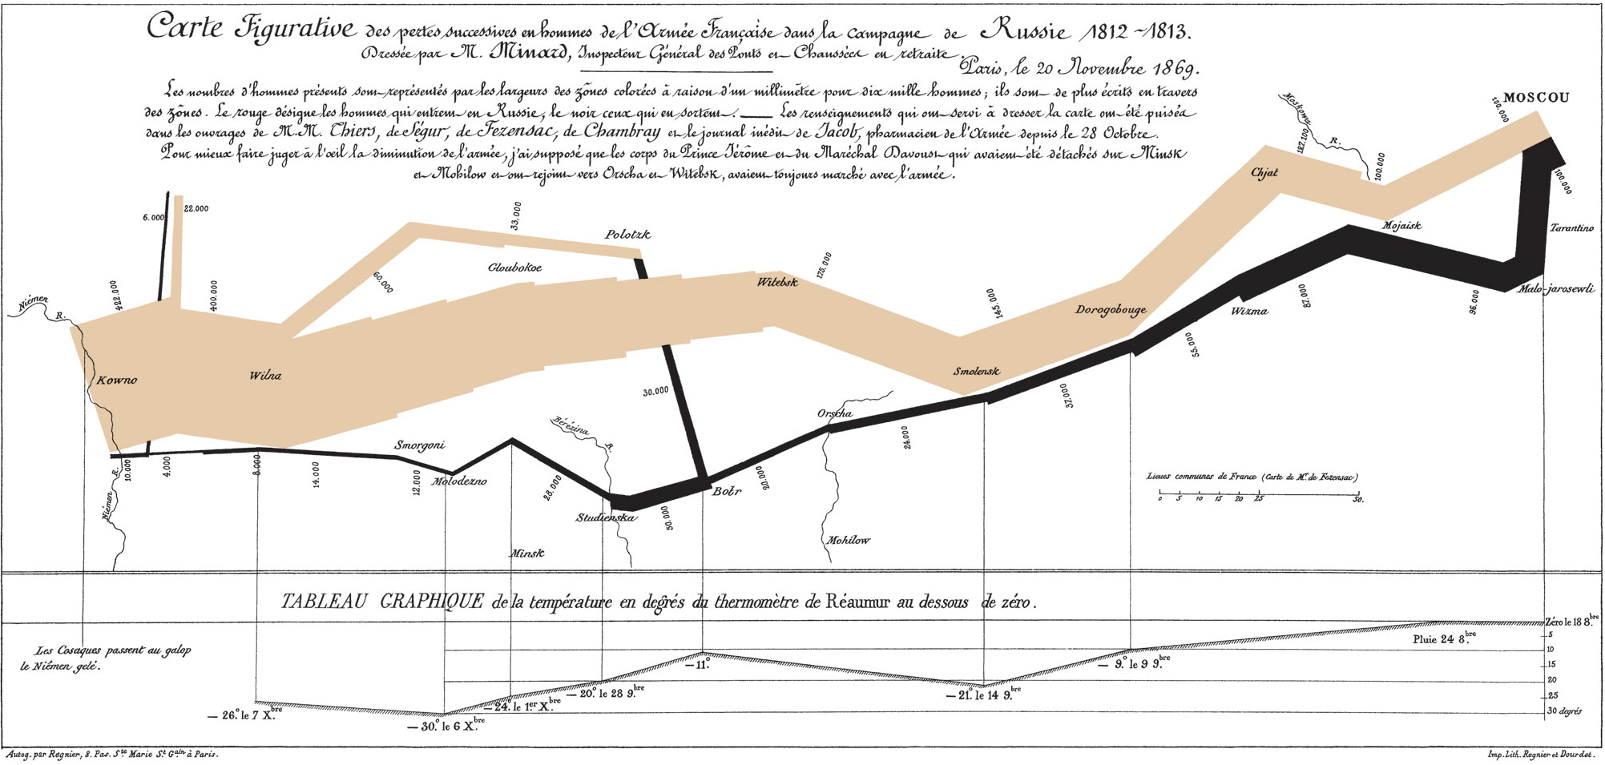
Minard’s depiction of Napoleon’s march to Moscow in 1812

Slide 12
Tufte vs. Kosslyn
Huge amounts of information condensed in a single visualization.
Tufte praises it, while Kosslyn criticizes it.
Five different variables are shown (the number of Napoleon's troops, the distance traveled, temperature, location and direction of travel). Violates the principle of capacity limitations.
Time flows on both directions (violates compatibility).
Small number at odd angles violates capacity limitations.

Slide 13
“Pascal’s wager”
Blaise Pascal was a French mathematician, physicist, inventor, writer and Christian philosopher
Should you believe in god?
There are four situations you need to considered, believing or not if god either exists or not.
There is big downside to not believing if god really exists, but there are small (or non-existent) downsides to the other three, so a rational individual should believe in god.

Slide 14
“Pascal’s wager”
 | God does not exist | God exists
Believe | ~ | +
Don’t believe | + | −
Graph from Stephen Kosslyn, Clear and to the Point, Figure 1.1.

Slide 15
The first principle of data visualization
Keep function over form:
“The first goal of an infographic is not to be beautiful just for the sake of eye appeal, but, above all, to be understandable first, and beautiful after that; or to be beautiful thanks to its exquisite functionality.” – Cairo.
“Any graph should be beautiful, but never sacrifice the integrity of the data just to make your design pretty!” – Cairo.
Tufte’s “maximize the data-ink ratio” principle is a similarly useful guide, but should not be taken to extremes.

Slide 16
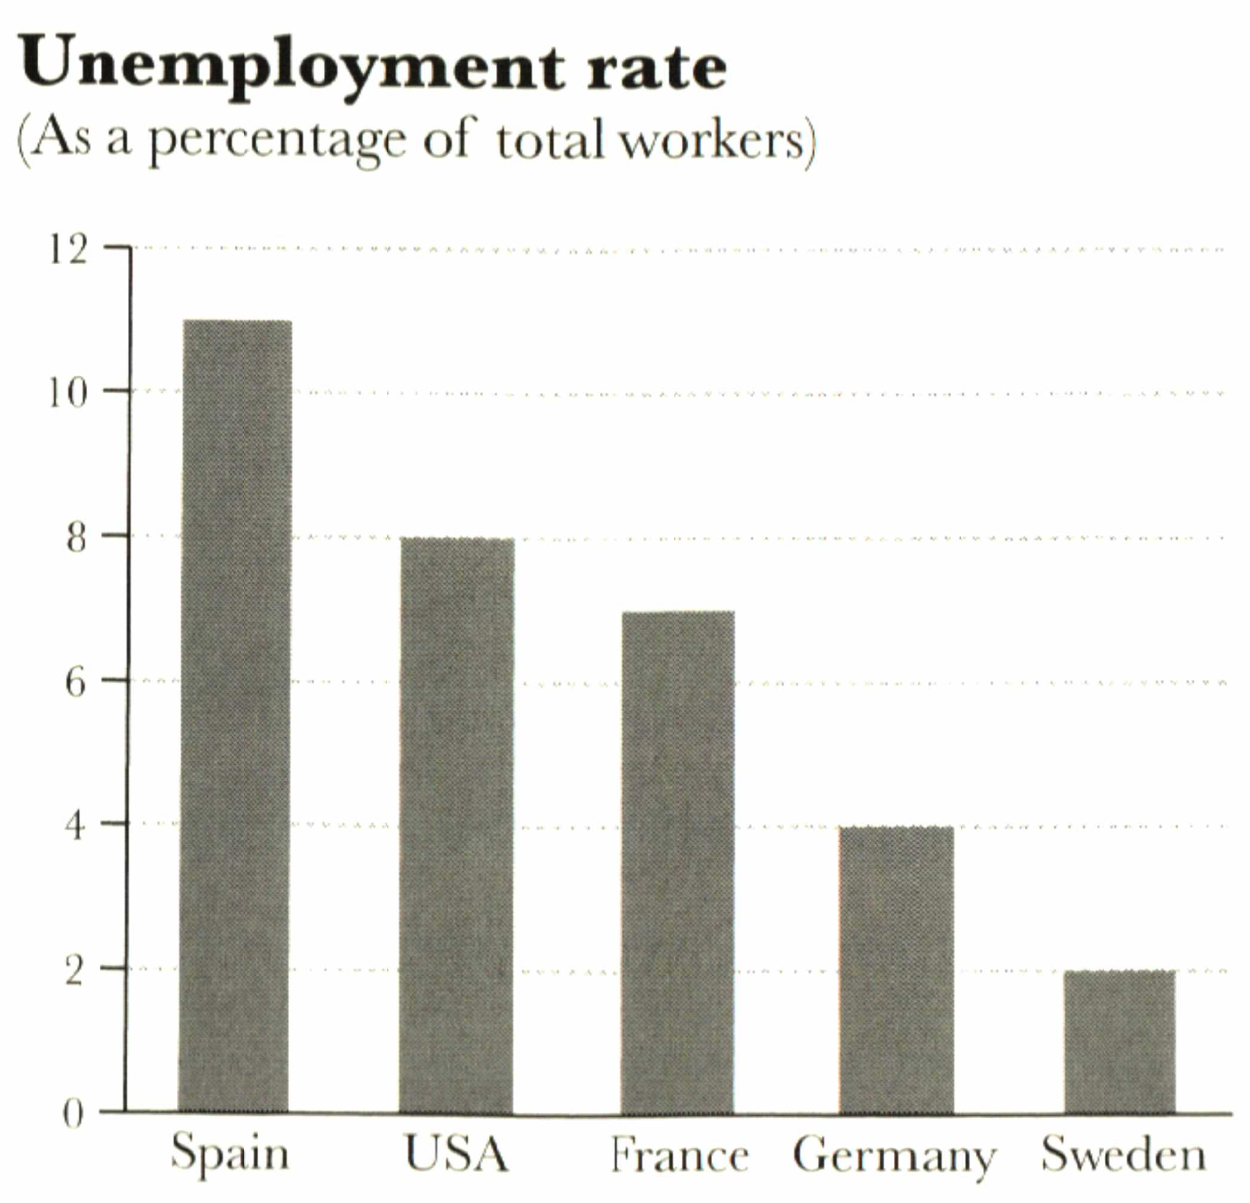
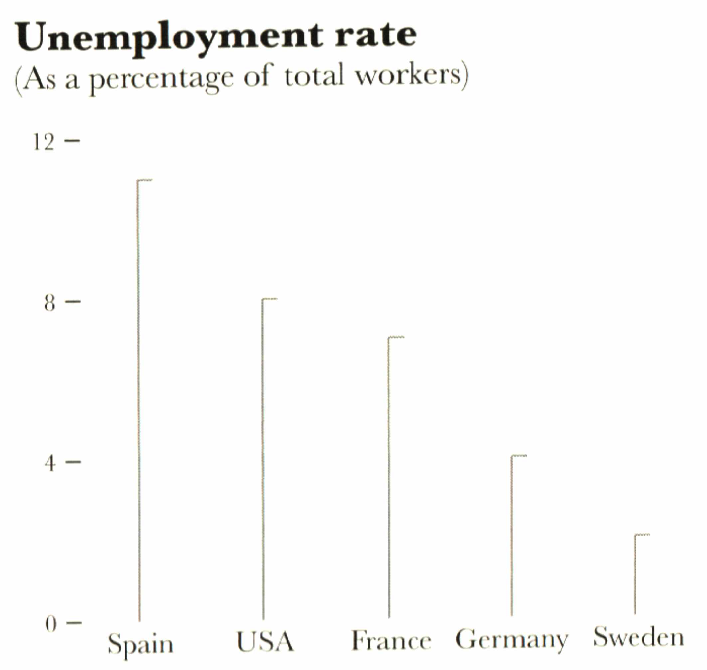
Maximizing data ink ratio taken to an extreme …
Graph from Alberto Cairo, The functional art, Figure 3.13.

Slide 17
Maximizing data ink ratio taken to an extreme …
None of the two graphs will set any pulse raising, but I would argue that the first one is a bit more appealing than the second!
People are “used” to certain types of graphs. Minimalistic versions of them tend to be a poor choice.

Slide 18
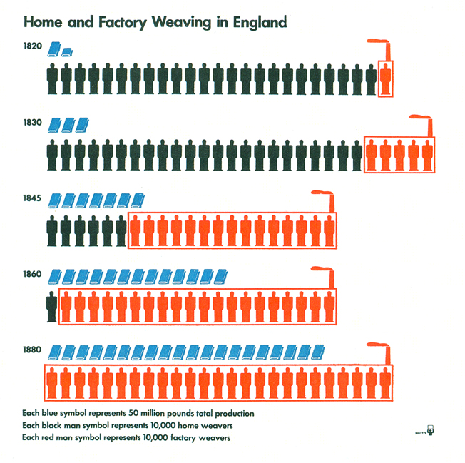
A little chartjunk can be useful, if it enhances meaning …
What conclusions do you draw from this graph?
Different shapes for different data help with comparisons.
Chimneys useful to distinguish between home and factory weavers (which is key to the story behind this visualization)!
Overall, visually appealing!
Otto & Marie Neurath Isotype Collection, University of Reading
Graph from Alberto Cairo, The functional art, Figure 3.18.

Slide 19
But again, be careful …
The previous graph is an example of a unit chart:
“A chart used to communicate quantities of things by making the number of symbols on the chart proportional to the quantity of things being represented. For example, if one symbol represents ten cars and five symbols are shown, the viewer mentally multiples ten times five and concludes that the group of symbols represented 50 actual cars.”

Slide 20
Unit charts
For the most part, unit charts are employed exclusively by newspapers and magazines.
Some people (such as Stephen Few) think that unit charts are useful “only for first graders”:
http://www.perceptualedge.com/articles/visual_business_intelligence/unit_charts_are_for_kids.pdf
Pre-attentive vs. sequential tasks: pre-attentive tasks are easier and faster to perform, so graphs that use them are typically easier to understand!

Slide 21
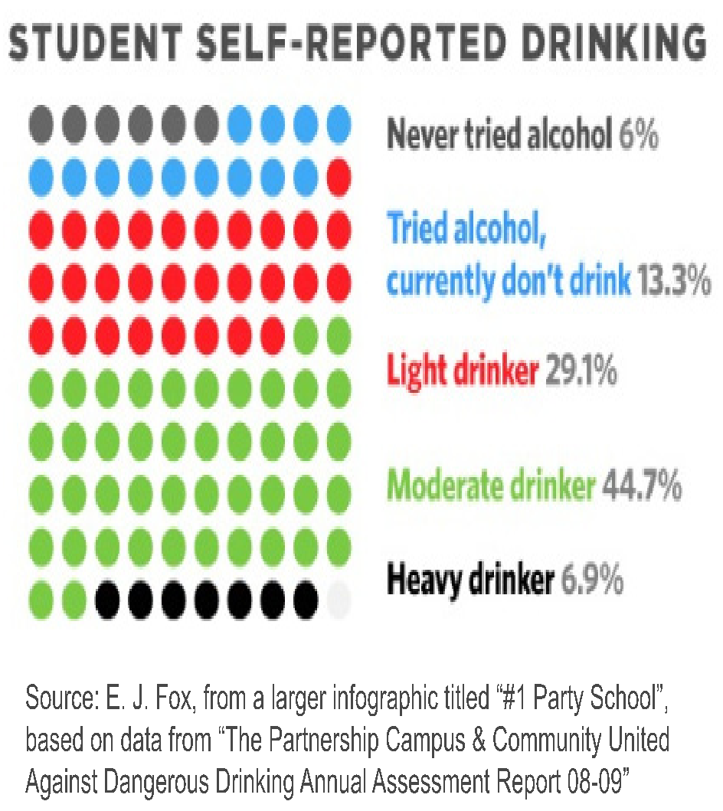
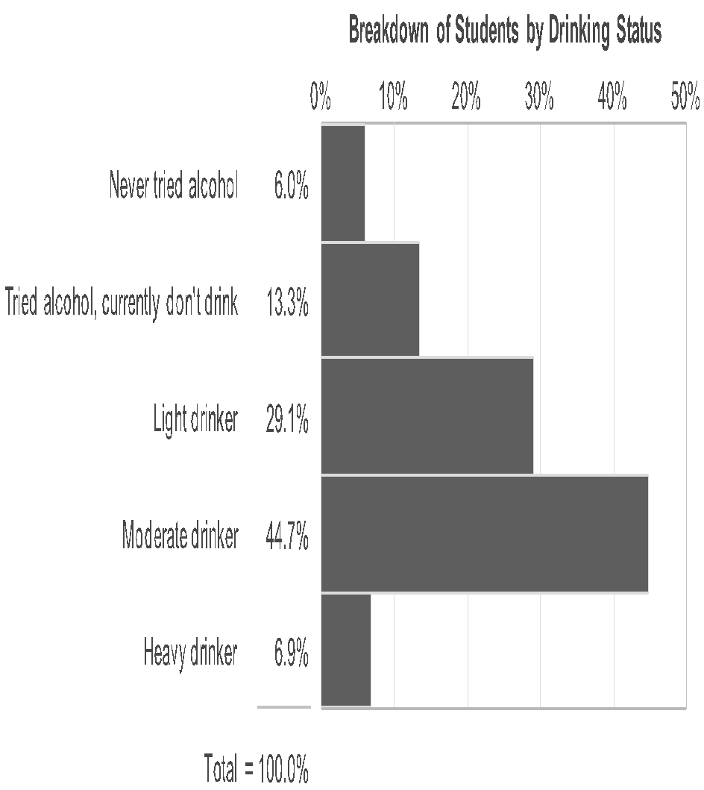
Two different ways to visualize the same data
http://www.perceptualedge.com/articles/visual_business_intelligence/unit_charts_are_for_kids.pdf

Slide 22
Which visualization is better?
Since the goal is to compare the relative sizes of the groups, the second graph (the bar plot) is preferable to the first (the unit chart).
Note, however, that the “Home and Factory Weaving in England”, in spite of being a unit chart, does not have the same problem because the symbols are stacked in bars … so it is just a pretty bar plot!
How could you improve the unit chart in this example? What would be the difficulties?

Slide 23
In summary …
“Chartjunk” should be minimized, but it can be useful, either as attention-grabber or as a mnemonic enhancer.
Personal recommendation: If in doubt, err on the side of not using it.
However, the final decision depends on your audience, which brings us to …

Slide 24
Second principle of data visualization
As in writing, keep your audience in mind when you create a visualization or infographic.
Is the visualization intended for a general audience or for a technical one?
Do you expect them to be interested in the topic, or do you need to call attention to it?
Do you expect them to be receptive to your message?
How familiar is your audience with the types of graphs you are using?

Slide 25
Second principle of data visualization
Similarly, keep your goal in mind when you create a visualization or infographic.
What is the point you are trying to make?
Are you trying to compare?
If multiple comparisons could happen, which one should take priority?
Try to anticipate what the user will want to do with your graph!

Slide 26
Second principle of data visualization
However, do not underestimate your audience either!
Tufte argues that you should assume the reader’s interest and intelligence.

Slide 27
Other useful suggestions …
In complex graphs, use small multiples (repetitions of a basic design) .
Once your mind understand one piece of the plot, it is much easier to understand the rest!
Symmetry is beautiful!
This is one of Tufte’s “principles”, and is related to the idea that you should create visualizations that create useful comparisons.

Slide 28
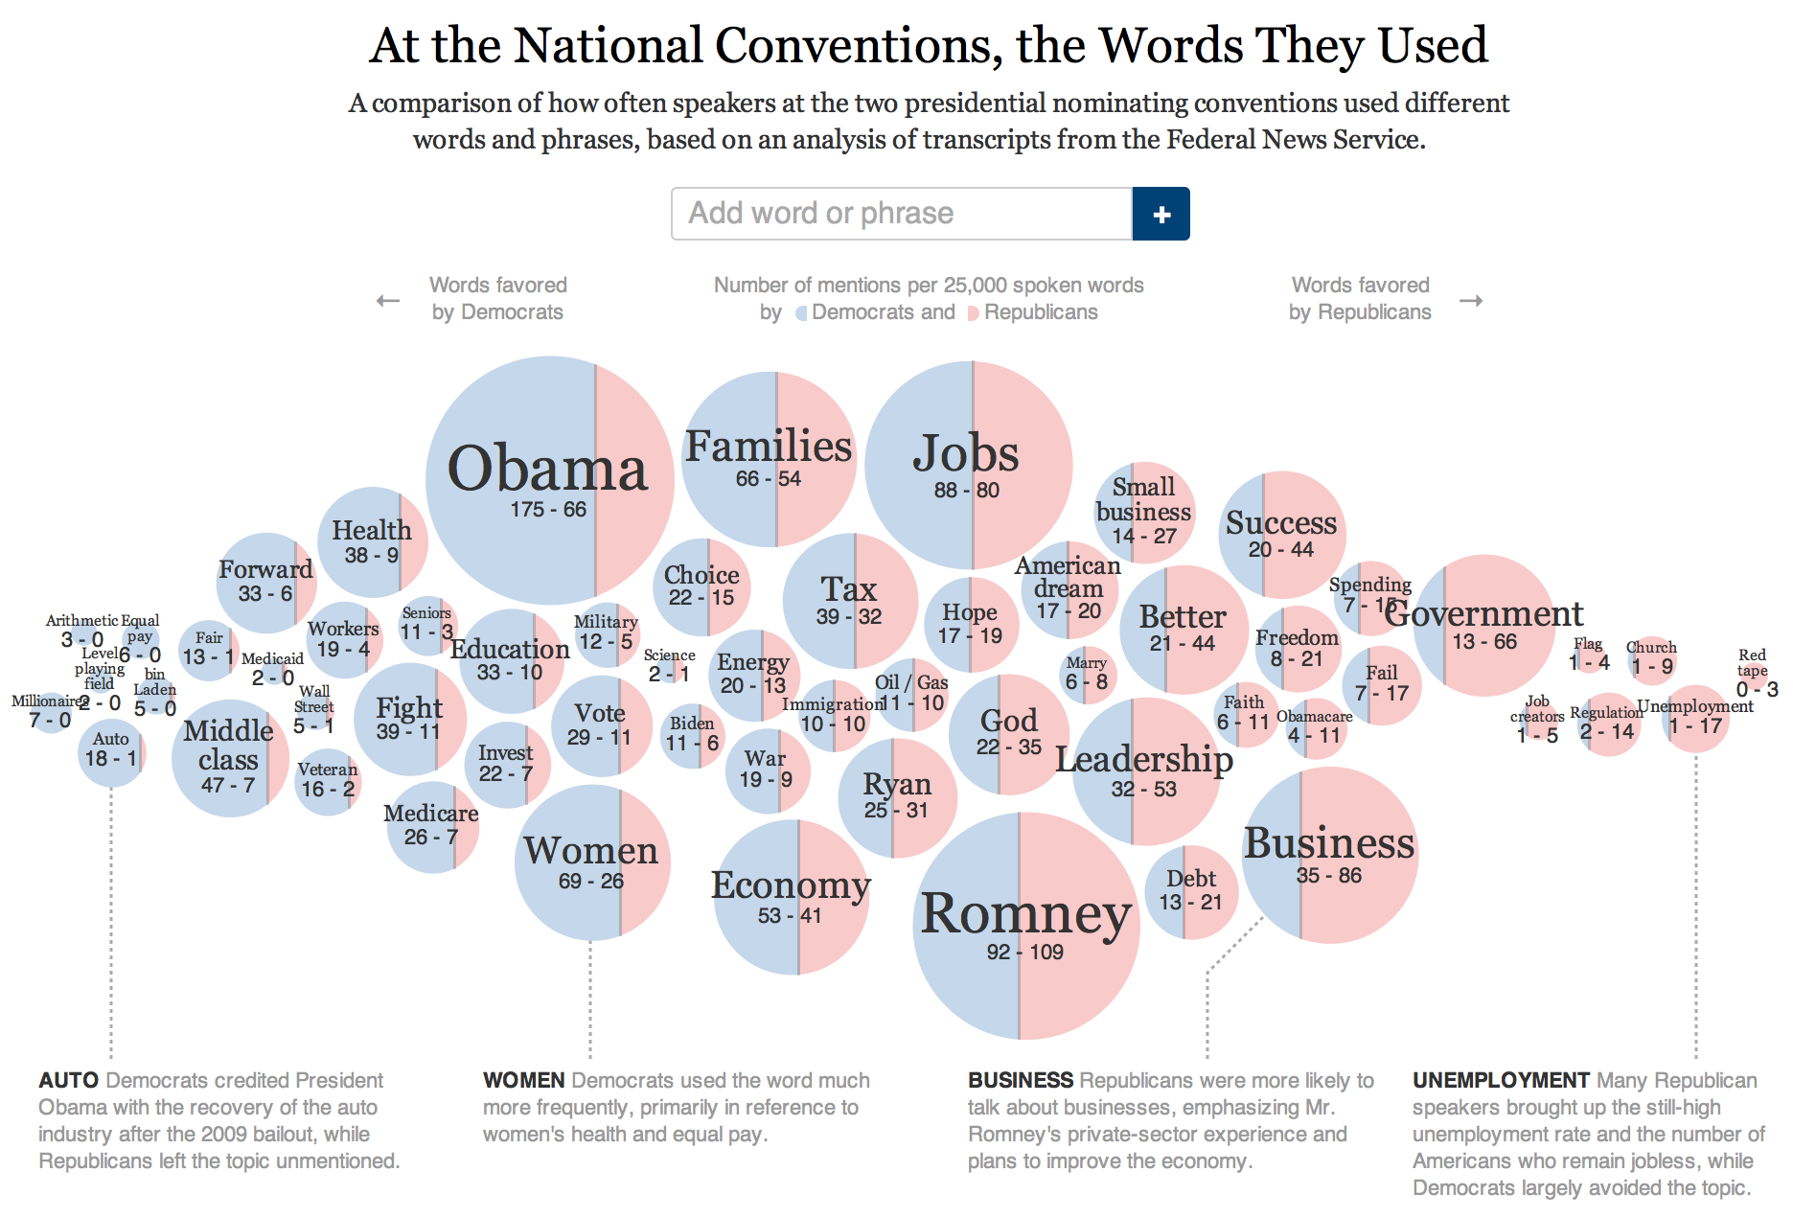
Using small multiples
http://www.nytimes.com/interactive/2012/09/06/us/politics/convention-word-counts.html?_r=0

Slide 29
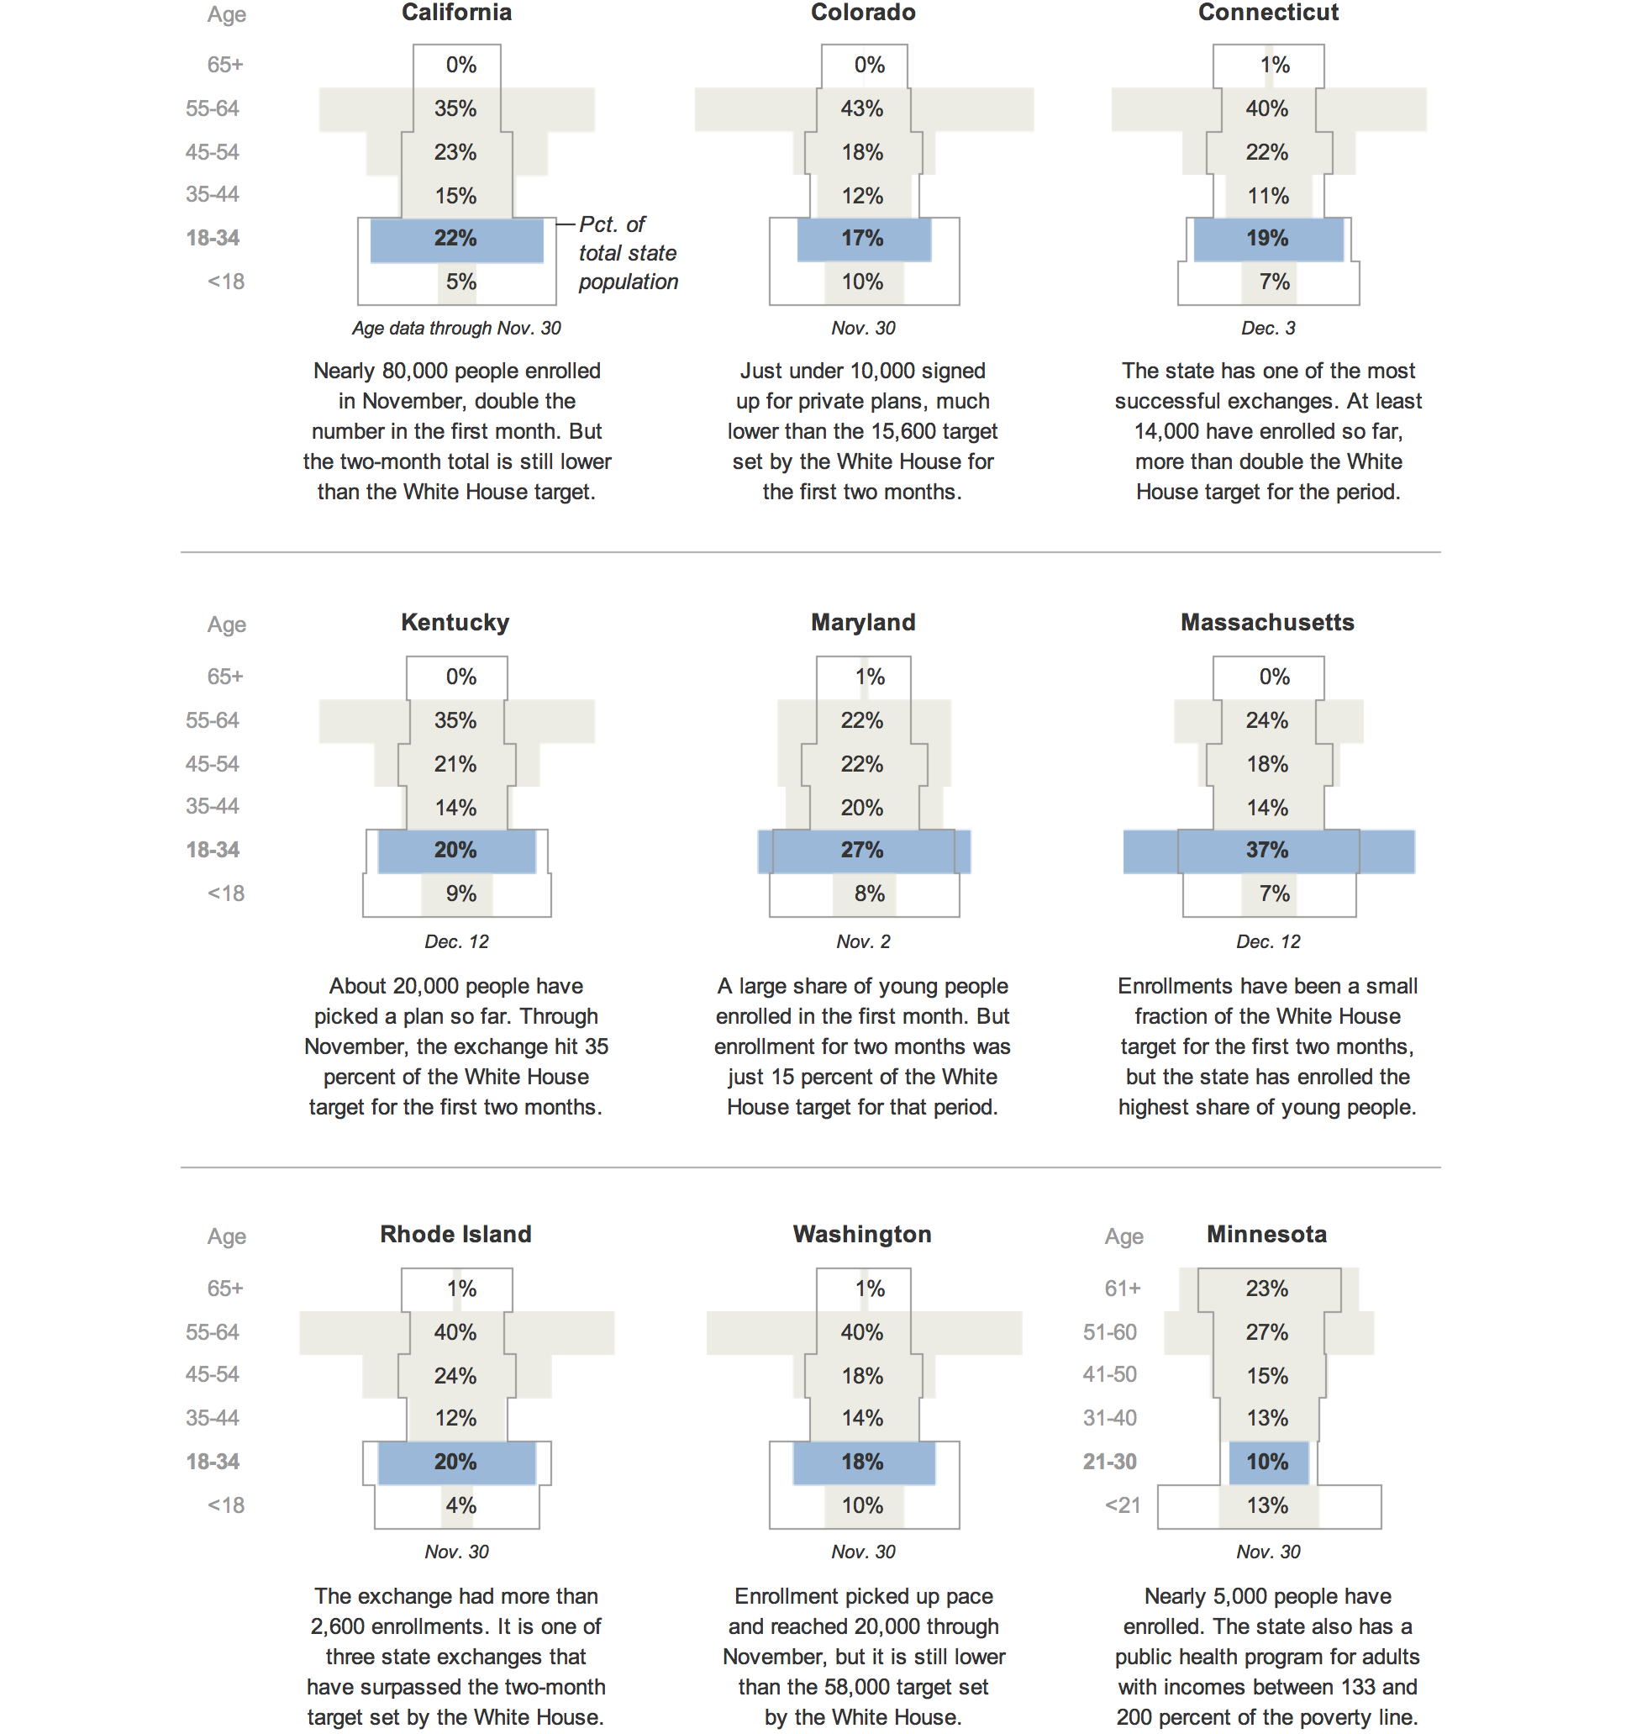
Using small multiples
At least two different types of comparisons can be made here:
For a given state, the predictions vs. the truth.
Truth across states.
What is this visualization good at?
http://www.nytimes.com/interactive/2013/12/14/us/tracking-the-ages-of-health-care-enrollees.html?hp

Slide 30
Other useful suggestions …
Include contextual information:
Units of measurement.
Dates.
Legends.
Reference values (typical values, values from previous years).

